Slide 1
Java SE 17 – Presentation
Chapter 13 – Concurrency

Slide 2
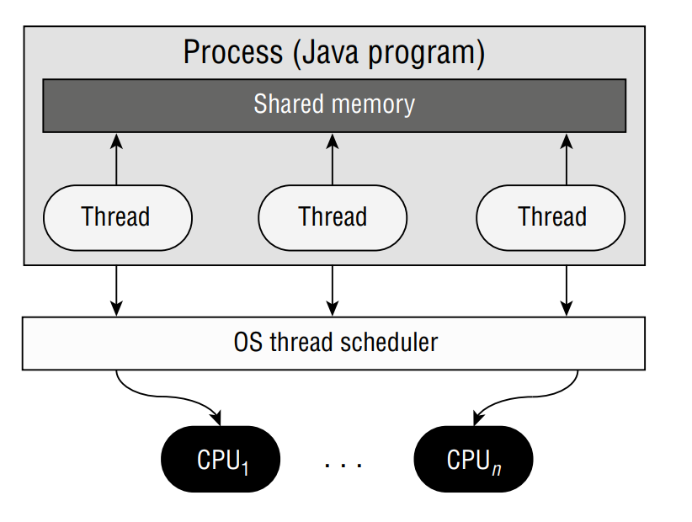
Chapter 13 – Concurrency
Introducing Threads
- We start this chapter with some basic ... about ... A Thread is a unit of ... (the smallest ... that can be ... by the OS ....)
- A ... is a sets of Threads .... shared in a ...
- Single .... is a process with ...
- Multi ... is a process with ...
– A shared ... means ... in a process share the same ... and ... each other ...
– A ... is ... job for ... In this chapter, a ... will be implemented as ...
- A ... can ... multiple but ... only ... at a time...

Slide 3
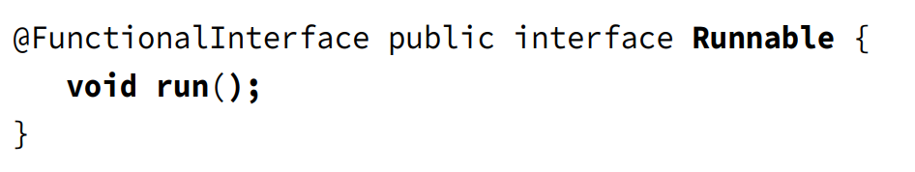
Chapter 13 – Concurrency
- Shared memory means ... variables, ... variables, and ... variables passed into a ...
- If a Thread ... a ... variable... then other ... can also ... the updated ... (question 1)
Understanding Thread Concurrency
- The property of allowing ... at the same time is called Concurrency. How can OS decides which .... when there are ... more than ... of the CPU ? OS will use something called ... to determine which one will be ... (for example, an OS ... will ... Round-Robin schedule). This makes sure that each ... will recieve enough ... and ...
- When the time ... for a ... runs out but the ... still processing => An event called ... will happen.
- Context switch is a process ... and restore ... (however, a cost to this is ... time ...)
- Newest OS ... are clever enough to ... the time of ... happening and still make sure that the ... smoothly ...
- Finally, a Thread can be ... or ... if there are other Threads that has ...
- A Thread ... is a ... value linked with the Thread and used by .... to determine which ... In Java, this value is a ...
Creating A Thread
- The easiest way to assign ... for a ... is to use a ... instance. ... is a FP and doesnt ... or anything ...

Slide 4
Chapter 13 – Concurrency
(code illustration snippet 1)
- This code will print ... or ... ? The answer is ...
– Both of the result could ... and depends ...
(code illustration snippet 2)
- The result is ... this is just one of ...
– Note: If we use ... on 3 threads, then one thing is certain is that ... will be on ... and ...
– Other than 3 defined ..., there is another ... which is ... Each Thread is ... and executes ... as something called ... Task
- Asynchronous ... means the thread calls ... threads and doesn't ... for other ...
– The opposite of ... is ..., which means ... for the others then it will ...
– Although the order for ... is ..., the order of ... inside ... still ... (question 2)
Calling run() instead of start()
- In the exam, we must ... with the code that tries to ... using ... instead of .... Call ... on .../... won't create a .... Although these code ... but there will be no ... on a separate ...
(code illustration snippet 3)
- Different from ..., each line will ... and the next ... The output is ... for every ...

Slide 5
Chapter 13 – Concurrency
- There are ... to create a ... and its ...
+) Create a ... implementation (or use ... instead) and pass into ... constructor ...
+) Create a ... for ... class and override the ...
- The book priotitizes the ... method because it is easier to ... (... API) and the ... method is used only in ...
Distingusishing Thread Types
- All Java ... including ... in the books are a ... program since it includes ... thread
– System thread is created by ... and runs on ... of the program (for example, ... is managed by ... thread in JVM)
- ... thread is the thread created by ... to achieve certain .... Most of the program we know only has ... thread, which used to call ... thread ... (for simplicity, we can call this as single...)
- both ... thread and ... thread .. can be ... thread..
– Daemon thread is the thread that allows ... to exit when .. A Java program will ... when there are only ... threads (for example, if ... is the only thread, then ... automatically ...)
(code illustration snippet 4)
- Same as last time, the ... is just one of ...
– If we try to change the ... to ...
(code illustration snippet 5)

Slide 6
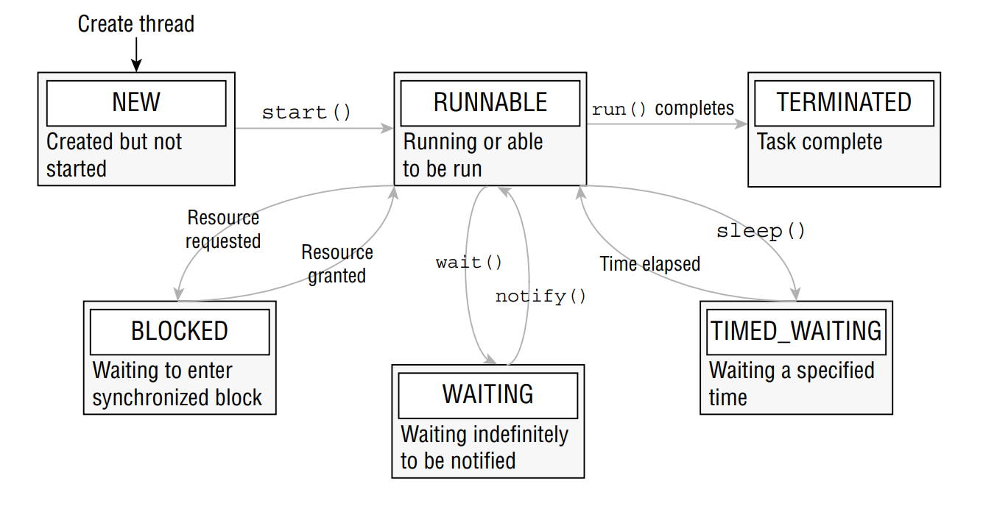
Chapter 13 – Concurrency
- Because this is ... thread, JVM will ...
- In the exam, just remember that ... # ... and it will ... until ...
Managing a Thread's Life Cycle
- After a Thread is ..., it will be in ... of the 6 states. We can get its ... by using ...()

Slide 7
Chapter 13 – Concurrency
- Every Thread will be ... with a "..." state. Once we call ..., the thread will move to ... state. However, this doesn't guranteed that the thread is ... or ... (it could be ... or ...)
- Runnable state only means ... can be .... Once the Thread is ... or get ... Exception, the Thread move to the .... state where it has no more ... to do
– When the Thread is on Runnable state, it could also change to ... 3 states where it ....: ...., ..., and ....
– The previous graph shows ... common ... between ... (for example, a thread that is in ...state can be triggered with ...() and a thread that is ... by another ... will exit from time.... state back to ... state
- We will talks about some (but ...) of the ... transisition (wait(), notify(), and join() will not ...). We should not use these ... and should use ... as much as we can (question 3)
Polling with Sleep
- Although ... program allows us to ... multiple ... at a time ..., but ... must wait for other ... to ... A solution to this ... is to use ...
- Polling is a process of checking ... after ... certain ...
(code illustration snippet 6)
- How many times does ... out ? The answer is ..., it depends ...
– But why does a ... without ... is bad ? Because a thread will always at ... => ... CPU and run out of ... for other ...
(verification required)

Slide 8
Chapter 13 – Concurrency
- We can enhance the ... by using ... to implement ...
(code illustration snippet 7)
- Although it is just a ..., but it is enough for CPU to ... other and instead of .... Notice that the ... thread will change ... state to ... state when ...
- Continue with the question, how many time ... executed ? The answer is ..., it depends on ...
– Although implementing ... will reduce the risk of ... (because CPU ...), it can't gurantee when ... terminate ...
– There will be chances where ... too long and run out of ... => CPU ... the ... and context switch for other ... => then it wil restore ... => keep doing this ... => multiple execution of ... => unable to predict ... (verification required)
- Another problem is the ...variable, if another ... tries to ... when other ... tries to .... => there will be .../... values (questions4,5)
Interrupting a Thread
- Our previous program can prevent ... too long in ..., but it has a problem, which is ... cost ... 2.1 seconds to ... and it will be 3 seconds because of ...
- A way to stop this is to ... when it's done
(code illustration snippet 8)
- Our improved ... includes ... to prevent ... CPU and ... for the ... thread to ... when it's done. When main() ..., it will change from ... to .... and when the ... thread is done and ... thread is interrupted ..., it will change back from ... to ... and, causing a ... to be triggered ... => stop the ...

Slide 9
Chapter 13 – Concurrency
- Call ...() on a thread that is already in ... won't .... In fact, it will change its ... when we periodically call ...is...()
Creating Threads with the Concurrency API
- Java includes ... packages. This is the Concurrency API. It is used to handle complex ... and managing ... for us
- Concurrency API includes ... interface, which is used to create a ... that creates and ...
- We first must get an instance of ... then we will send ... need to do to ...
- This framework comprises of ... such as thread ..., thread .... We are encouraged to use this ... when ... task ..., even if we are working on single ....
– When working with a multi ... we should use ... instead of ... object directly. These libraries are much more ... and ... and capable of ... complex ...
Introducing the single-thread executor
- ... is an interface, how can we get the instance of ... The Concurrency API includes ... class that has ... method to get the instance of ...
(code illustration snippet 9)
- In this example, we implemented ... to create a Service. Differ from the last example, this time we only have ... thread (... and ...). However, the output is still ... but it will have less ... than ...
- Notice that the tasks are not ... anymore. With ..., tasks will certainly be ... in order and only ... thread will ...

Slide 10
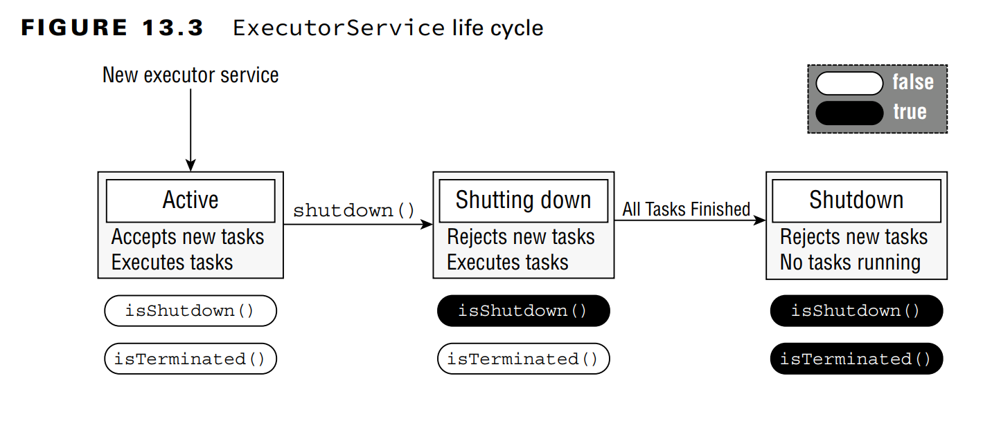
Chapter 13 – Concurrency
Shutting down a Thread Executor
- Once we finish with ..., there is an important ... must do ... is ... the Executor...
- A .... will create a non-... thread, and if we don't ..., then the program will ...
– The process of ... the Executor is:
+) First, ... any tasks that ... new ...
+) Meanwhile, ... last ... running ... (during this stage, calling ... true and ... false)
+) If any tasks that ... during ..., ... RejectedExecutionException ...
+) When all ... the call for ... and ... true

Slide 11
Chapter 13 – Concurrency
- For the exam, we must remember that ...() won't ... submitted ... for the ... before the ...
- If we really want to ..., we can call ...Now(), this guy will try to stop ... current... and reject all ... submitted but not ...
– There will be chances that this guy won't ... because we can create a ... thread that's ... => Any ... will be ignored ...
- As we studied in chapter 11, resources like ... must be properly ... to prevent a ... However, such ... aren't implementing ... interface => try ... can't be used ... but we have to use try .... Although this is ..., we are recommended to ...
Submitting Tasks
- We can submit a ... to ... Service though many ...
- The first way is ... which we presented.... The method ... is ... Executor interface ... (which also the interface that the ... inherited ...). This method accepts 1 ... task and complete ... asynchronously ... Because ... method doesn't ... anything, it doesnt tell us anything about .... of the execution
- This is a type of "fire-and-forget" ...
– Luckily, JDK devs included another ... called ...() for ... interface. It looks like ...() but it return something called ... instance, which is used to determine whether ... or not ...
– It also used to return ... after completion ...

Slide 12
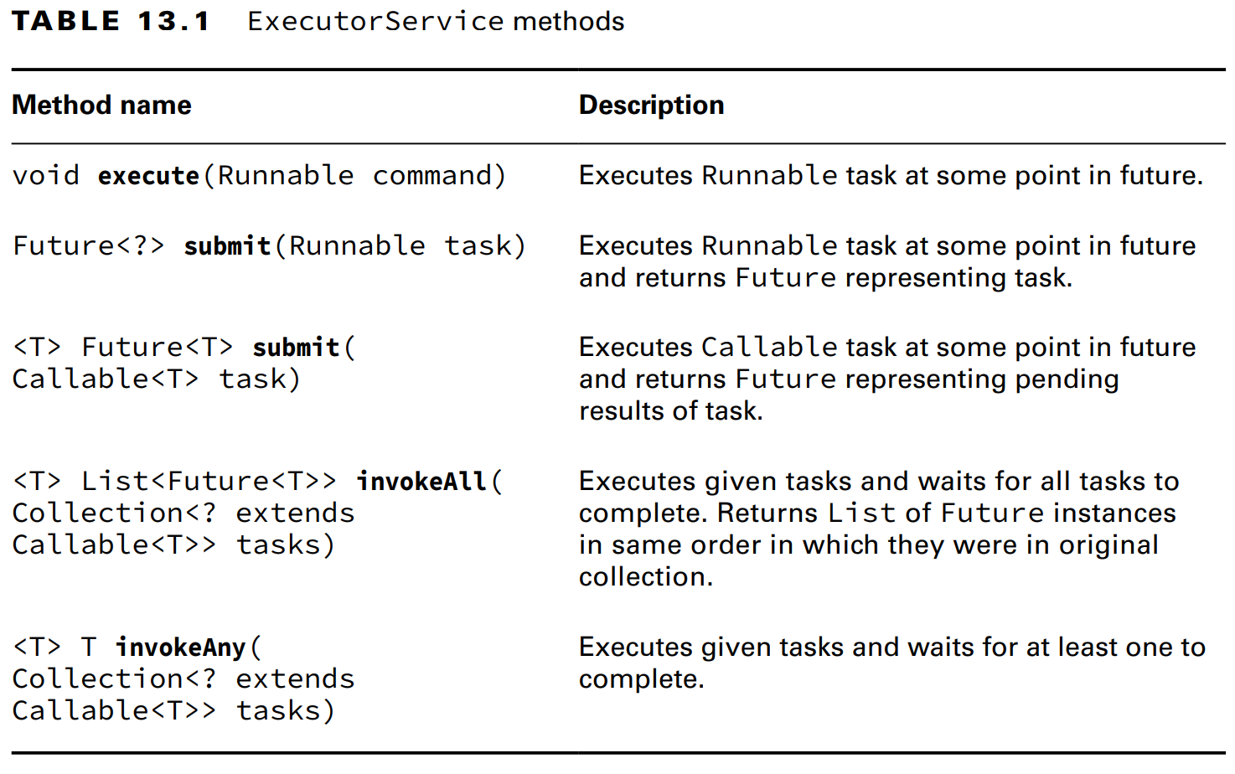
Chapter 13 – Concurrency

Slide 13
Chapter 13 – Concurrency
- We can see that, both ...() and ...() are almost identical. When used with ..., ...() obviously has more advantage than ...() because it returns ... used to monitor ... while ...() doesn't ...
– That's why people like ...() than ...()
Waiting for Results
- How can we know when ... submitted to ... is completed ? As we mentioned that submit() returns a ... instance that can be used to ... result ..
– Future type is a .... In the exam, we don't need to know about its ..., we just need to know that ... type is returned by many .... API ...
- The table shows some method to ...

Slide 14
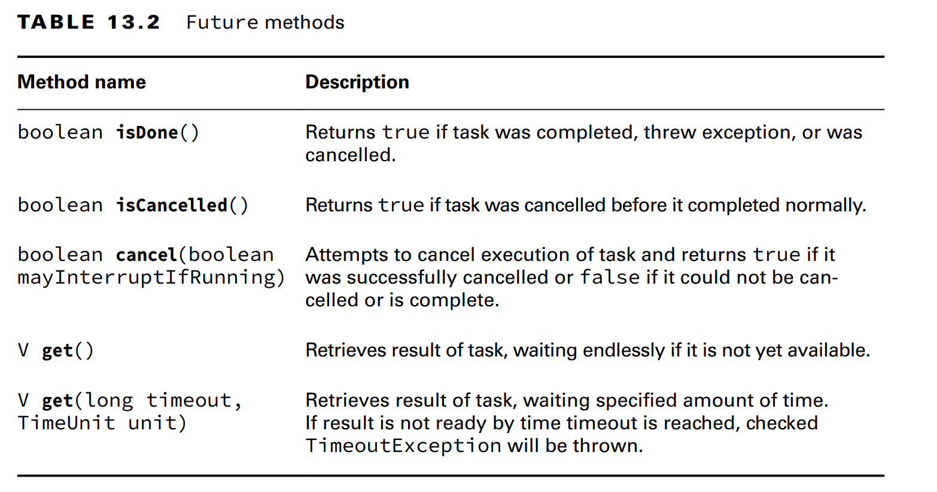
Chapter 13 – Concurrency

Slide 15
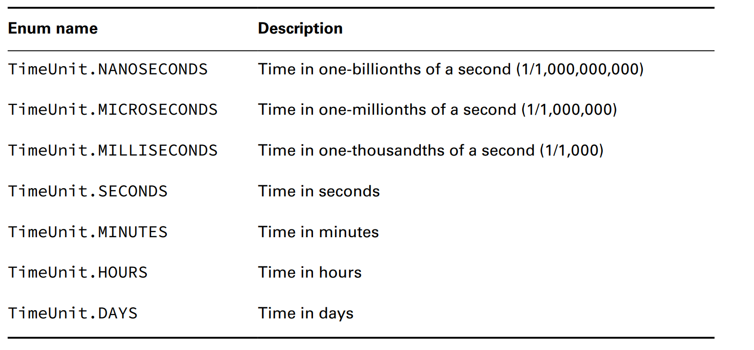
Chapter 13 – Concurrency
(code illustration snippet 10)
- This is the same as ... polling ... but not using ... class. This is the essence of ... API, where it is used to handle ... tasks and we don't need to ... directly ...
- This code also ... before it throws ...
- What is the return value of this task ? Because ... is a generic .., the type V is determined by the Runnable method. Since Runnable ... has return type ... => the ...() method will always ... null ...
– The ...() method also accept 2 optionals ... which is ... and ... for ... and ...
– We must know the ... enum because ... API uses it

Slide 16
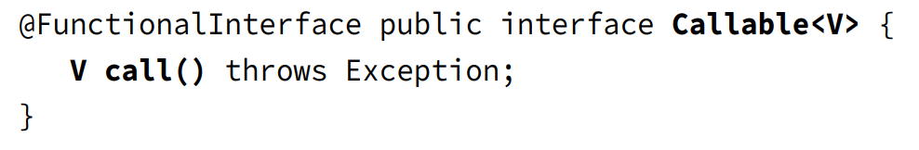
Chapter 13 – Concurrency
Introducing Callable
- ... interface is a FP and looks the same with ... interface, except the fact that ... it does ... a value and throws ...

Slide 17
Chapter 13 – Concurrency
- Callable interface is usually ... than ... because it returns ... easier ... when a task ...
- Even if so, we still use ... of ... and it can be interchangable in case where lambda doesn't throws ... and doesn't have ... type
– Luckily, ExecutorService includes ... version for ...() which recieves a .... and returns ... instance ...
- Differ from Runnable, where it always .... then ...get() will return a generic type (and also have a chances of returning ...)
(code illustration snippet 11)
- We can rewrite the code using ..., shared ..., interrupted and ... wait, but this code is far more ... and ... to understand... Basically, this is why ... API is born – to write the code that is ..., ..., and ...
Waiting for all tasks to finish
- After ... a set of tasks to ..., what we usually do is wait ... Like the last example, we have called ... on ... instance to get ... If we don't need the ... and done of using ..., we have a simpler ...
- First, we shutdown the ... using ...(), and then use the ...() method that is available to all ... This method will ... for a ... time for all ... tasks. This method will return ... if all ... or ... throws ...
(code illustration snippet 12)
(question 6)
Scheduling Tasks
- Normally in Java, we need to schedule a ... somewhere in the future. We even have to make a task that ... period ... in a time ... (for example, in zoo, we have to check daily the food for the ...)

Slide 18
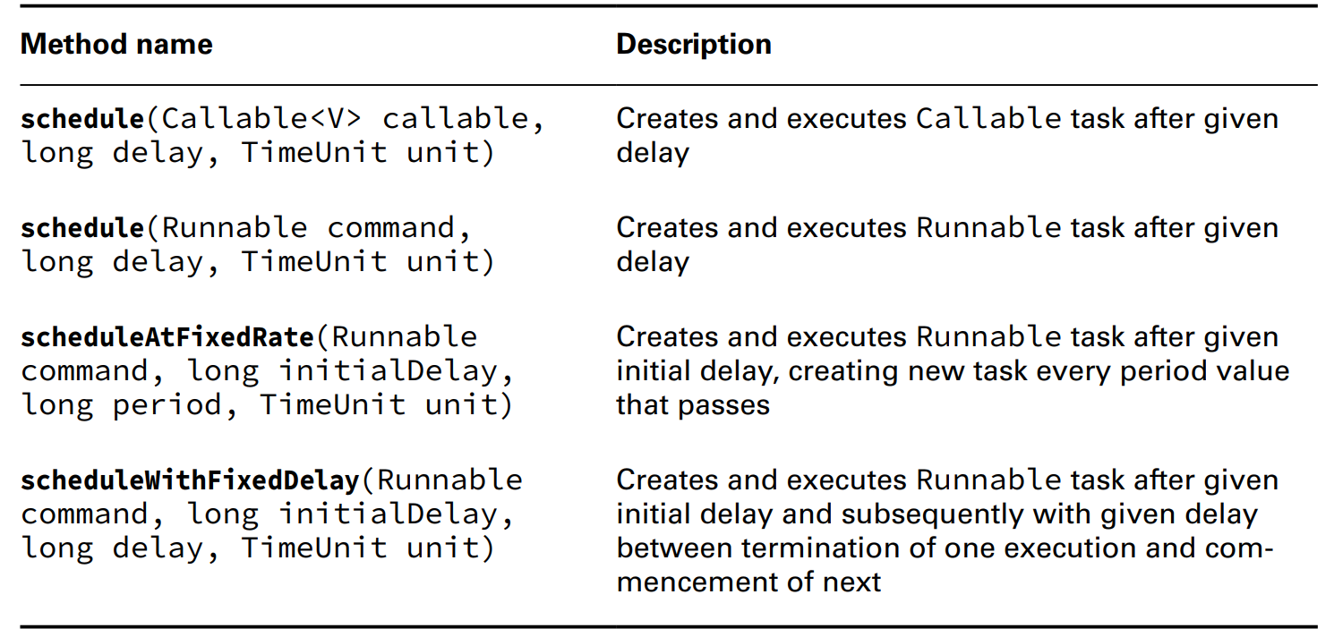
Chapter 13 – Concurrency
- We have something called ..., an sub... of .... Like ..., we can use ... method from ... class to get an instance of ... interface ...
(code illustration snippet 13)
- We can store the ... instance in ..., but obviously we will need to ...

Slide 19
Chapter 13 – Concurrency
- In real life, these are ... most ... in ... API because it ... complex in just a .... Delay and period all use ... enum as a ... (question 7)
- 2 method ...() recieve ... or ... and execute after .... The ... also the same but after the previous ... + a ...
(code illustration snippet 14)
- Meanwhile these tasks looks like they are ... in the ... The execution of ... could be ... (for example, run out of available ... => wait in ...). Moreover, if the service is ... then ... running will ... and all tasks that are ... will be ...
- Each method in ... are all important and serves different ...(for example: checking the cages in zoo regularly, could send noti or schedule another ..)
- scheduledAtFixedRate() ...
- scheduledAtFixedDelay() ...
– Some bad things could happen with scheduledAtFixedRate() if all tasks take .... than the delay (image this looks like a boss always ... at us ... each minute while we took 5 mins for each ... => soon enough, we will be ...). Executor will face the same thing, we just need enough time. The program will submit ... enough ... => program ...
- scheduledAtFixedDelay() is useful when ... daily ... but ... is not important ... (for example, a grocery store could runout of ... and ... 20 minutes to ..., however, we don't need to know when ... again, we just need to know that when it is ..., we need to refill)

Slide 20
Chapter 13 – Concurrency
Increasing Concurrency with Pools
- Until now, we are just working with single .... After all, "Concurrency" is the main topic of this chapter and we can't ... if we working with single ...
– Now we will introduce you with 3 new methods in ... class that works with ... pool ....
- Thread pool is a set of ..., and ... threads, ready to execute ... (check question 8 note on next slide)

Slide 21
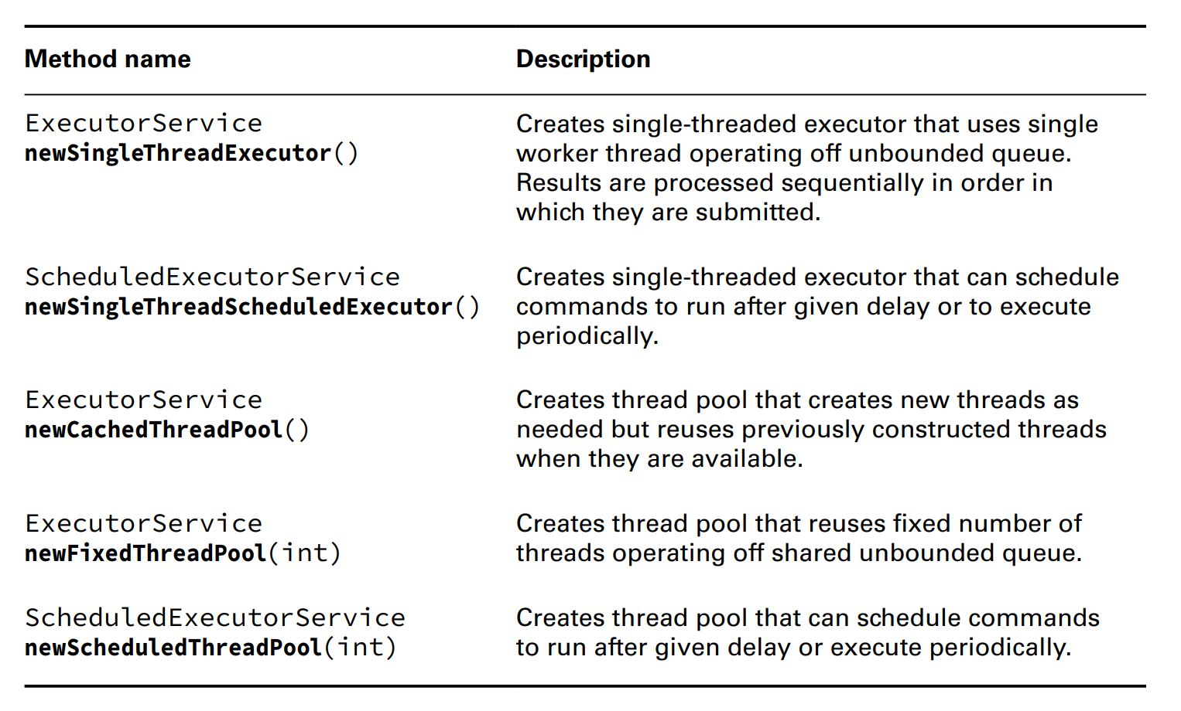
Chapter 13 – Concurrency
Notes:
Question 8

Slide 22
Chapter 13 – Concurrency
- In the table, most of the methods returns ... 2 ... which are ... and ...
– The difference between single ... and ... is what happen when ... running ... ?
- While single ... will wait ..., ... pool will deploy ... concurrently. If the pool runs out of ..., ... tasks will be ... and wait ...
Writing Thread-Safe code
- Thread-safety is a property of ... that gurantee to ... safely with multi ... at the same time
- Because threads run in the same shared ... and shared ..., how can we prevent ... conflict ... We must organize the data to prevent .../... value. In this part, we will study about techniques to ... such as ...,...,..., and cylic ...
Understanding Thread Safety
(code illustration snippet 15)
- Usually, people think that the output is ..., however, ...
- Why does this happen ? In this example, we use pre... operator to ... the instance field, but there is a problem when both threads try to ... (both ... and ... at the same time) => This is redundant because the thread got ... by other ...

Slide 23
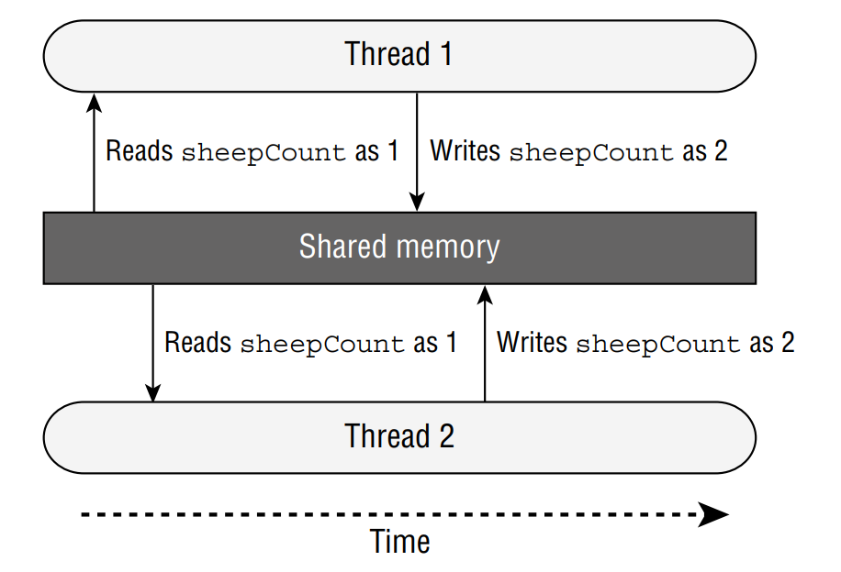
Chapter 13 – Concurrency

Slide 24
Chapter 13 – Concurrency
- As we can see that, both ... try to ... causing 1 operation to be ... => the ... is not thread-safe. Later on, we will understand the case where 2 ... overwrite ... are called ... condition
Accessing Data with Volatile
- The keyword volatile is used to ensure that the ... consistent (for example, there will be chances where the access to ... field is an invalid ... and causing .../... value while the code is on the most ... part). This is almost identical to the case where an employee tripping on the way back and another employee ... while the tripping one is trying to ...
- The keyword volatile will be used to make sure that there will be ... at a time ... the ... and this field will be ... consistently by other ... This is equivalent to no one will disturb the employee on his way back => Is the keyword thread-safe ?
(code illustration snippet 16)
- The reason this code is still not ... is because of the ... operator are still 2 separate ... If we write ... and ... separated out, then it will be ... but if we try to use ... (question 9)
- In real life, the volatile keyword is not ..., we just ... because it is on the ...
Protecting Data with Atomic Classes
- In the SheepManager example, we can see that the field ... 2 times with the highest (could be ... and could be ...) As we can see that the operator isn't ... and even if we use ... it is still ... It is ... because it has to do ... jobs at once (... and ...) and could easily be ... by other ...

Slide 25
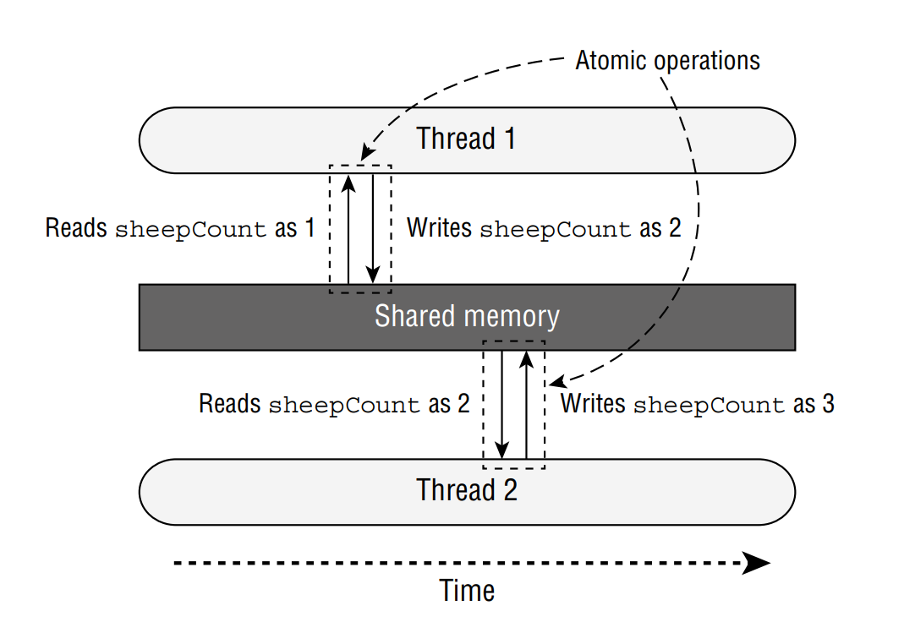
Chapter 13 – Concurrency
- Atomic is a word used to ... of the operation that can be ... normally without other ...
- A ... and ... version of SheepManager must do ... and ... at once and blocks ...
- In this case, any ... tries to .. must wait until that ...

Slide 26
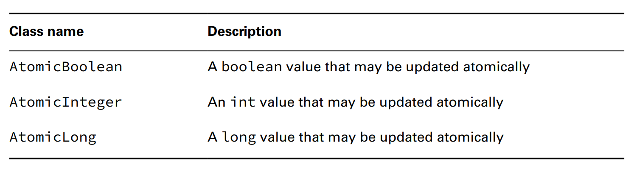
Chapter 13 – Concurrency
- Because accessing .../... field in Java is pretty ... => Java included some ... classes in ... package

Slide 27
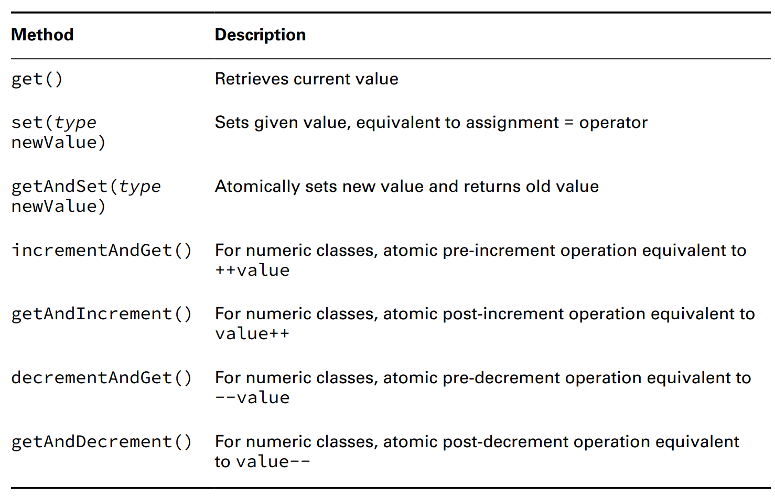
Chapter 13 – Concurrency
- How can we use ... ? Each of the class comprises of ... that equivalents to primitive ...
(the tables contains "type" which means")

Slide 28
Chapter 13 – Concurrency
(code illustration snippet 17)
- Although the input ..., the order is still ... this will be solved in ...), but for now, the ... problem have been solved
Improving Access with synchronized Block
- While Atomic class works very well in ... it doesnt useful when we ... a series of ... (for example, we can't use Atomic to ... Atomic ... at once)
- How can we force the workers to ... order ?
– The most common ... is to use monitor to ... the access
– The monitor (or ...), is a structure to support .... (a ... in Concurrency that ensure a single .... with ... at the ...)
- In Java, any ... could be used as ... with ... keyword ...
(code illustration snippet 18)
- This is an example for something called ... Each thread must first .... if any ... is using .... If there are no ... available ..., then that ... changes from ... to ... state until it gets the ... If there are ... available (or that thread has the ...), then that ... will enter the block and blocks all ....
- Once the ... completed, it will release ...
– To ... access for multi ..., each thread must have the same ... or else if each thread has ... => that code is not ...

Slide 29
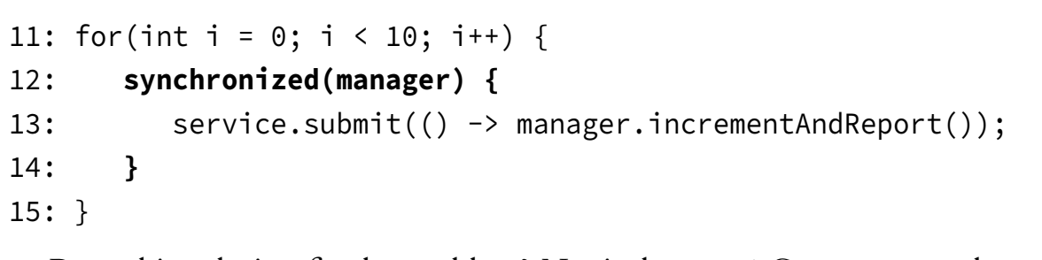
Chapter 13 – Concurrency
- Is this code thread safe ?

Slide 30
Chapter 13 – Concurrency
- This solution is not ... because it ... the process of creating .... not the ...
- If we write like this, we let the creation ..., but the tasks will still ... (question 10)
(code illustration snippet 19)
- Although the threads are .., but they all have to ... tasks
– We can synchronize on any ..., as long as ... has access to ... (question 11)
(code illustration snippet 20)
Synchronizing on Methods
- In the last example, we set a ... around the method by using ,... However, there is a shorter ... (which is compiler ...) which is adding a ... to the method so that it automatically ... with the object
(code illustration snippet 21)
- Moreover, we can use the ... for ... method, but the question is, we synchronize on which ... ? => We will use the ....
(code illustration snippet 22)
- We use ... synchronization when we want order ... on all .. rather than ...

Slide 31
Chapter 13 – Concurrency
Understanding the Lock Framework
- Synchronize block only ... a small ... of .... (for example, if we want to check ... is available or not ... if it is not ... then ...). Moreover, if ... never .... and we ... on it => We might wait ... Concurrency API includes something called ....
- The Lock interface is basically a ... but with ... more .... Instead of synchronizing on some ..., we can lock on ... that implement ...
Applying A ReentrantLock
- The ... interface is pretty easy to ... When we need to protect ... from ... processing, we create a ... that all ... can ... to ... Each Thread when ... will call ... before ... and call ... before ... Some of the examples here use ... keyword and .... While the code for .... longer, it has more ...
(code illustration snippet 23, 24)
- The ... class is a simple ... that implement ... and support ... feature so that only 1 Thread is ... at the same time ...
– Although it is not required, we are recommended to use ... clauses with ... instance. We do this to make sure that all ... is properly ...
- The ... class ensures that there is only 1 ... call ... method and acquire the .... Any thread that tries to call ... will need to ... Which Thread is ... depends on a single ... that is used to ... the Lock instance
– The ... class has a constructor that ... a single ... callled "..." parameter. If this parameter is set to ... then the order of the Threads acquiring the ... will be the same ...
- By default, this ... However, we should need to use this ... when we really ... as this will slow ...

Slide 32
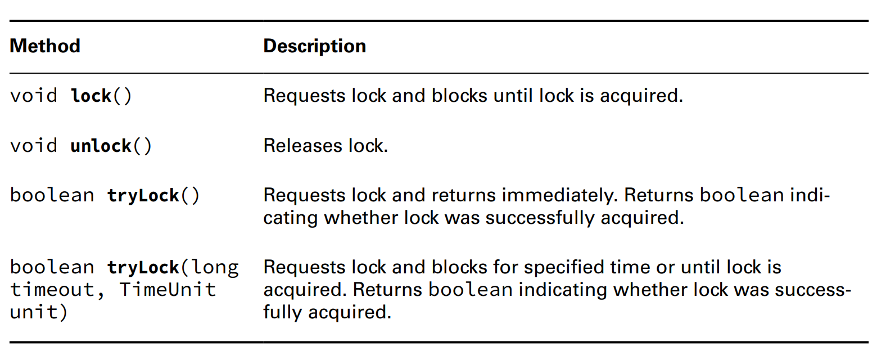
Chapter 13 – Concurrency
- Other than always make sure to ... the lock, we must understand that we only can relase the ... that we have
(code illustration snipppet 25)
Attempting to Acquire a Lock
- While ... class allows us to ... when acquiring ...., it will make the same ... as ... block. However, ... has 2 methods ... that makes ... safer to use ...

Slide 33
Chapter 13 – Concurrency
- The method tryLock() will try to ... and ... immediately a ... result to indicate whether ... Differ from the lock() ... this method won't ... even if ... no matter ...
(code illustration snippet 26)
- In theory, if user ... run then main must ..., otherwise, main ... and user .... However, ... always run first then ... => ...
(question 12, check Main4 class too)
- Same as ... method, tryLock() should be used with ... clause. But we just need to ... when we have successfully acquire the ... Because of that, people always use ... method in ... statement so that they only need to ... when the ... is acquired ...
- Our program must check the ... method. The result of ... method tells us should we continue with ... or release ... later on
- Furthermore, tryLock() has another version that ... 2 ... This guy is no different than ... combined with ... If ... is available then it will ... but if it is available, then ... If after ... it will return ...
(code illustration snippet 27)
Acquiring the same Lock twice
- The ... class holds a counter ... that counts the ... time that ... release ...
– To release ... for other ..., the number of ... must = to the number of ...
(code illustration snippet 28)

Slide 34
Chapter 13 – Concurrency
- In general, the ... class supports ... that simillar to ... class but have some more ...
+) ... request ... without ...
+) ...request ... without ... + .... for a time ...
+) A Lock can be created with ... parameter, indicating ...
- Although this is not in the exam, ... ReentrantReadWriteLock ... is a really useful .... It includes separate ... for read/write and useful for some ... struct... that has ... more than .... (for example, if you have 1000 ... but with 1 ..., then ...)
Orchestrating tasks with a CyclicBarrier
- We started ... thread safe ... with protecting ... to ... and to ... and even used the ... class/interface
– Now we will end this topic by instruct you how to use ... to ... tasks with many ...
- We have a cleaning teams, responsible for cleaning the ... Just image this job as ..., then ..., and then ... (assuming that a team has 4 ...)
- We can obviously assign this to ... only, but if we do that, then we will be .... Do a set of ... then ... and then ... will be much ... => We can achieve that by ...
(code illustration snippet 29)
- As you can see, the output is ... => ...
– We can improve this by using ... The constuctor of ... recieve ... (indicate how much ...) When each ... finish ..., it must ... in the ... class. Once the number of ... reached, ...

Slide 35
Chapter 13 – Concurrency
(code illustration snippet 30)
- The ... class allows to ... complex, multi... while ... stop at a logical point. This solution is .... than single ...
– After the limit of ... class reached, all thread will be ... and the counter ... and now the ... instance is ready to ... for a new ... (for example, if we have 15 ... and the ... is 5 => the ... class will run a total of ... time) (Note: the number must be ... or else ...)
Using Concurrent Collections
- Other than managing ... for us, Concurrency API also includes ... and ... allowing us to coordinate ... to a single ... from multiple ... In this section, we will talk about many ... classes that are available in Concurrency API
Understanding Memory Consistency Error
- The purpose of ... classes is to solve common ... problem.
– Memory consistency error happens when 2 ... has 2 different ... on a single ... which in theory should be ... In concept, we are finding a way so that when a ... try to ... on a single collection must be readable by other ...
- When 2 ... try to modify a non ..., JVM could throw a ... at runtime. This can even happen with single ...
(code illustration snippet 31)
- This code will throw ... because ... on keySet() ... updated with ... after ... We only need to change from ... to ... and it will be fine
(code illustration snippet 32)

Slide 36
Chapter 13 – Concurrency
- Although we don't change ... loop ..., that example still points out that the ... class has ordered the .../... so that all ... to the collection is ... In that code, the iterator created by ... ...ed immediately when it has ....
- All ... classes are created to ... common problems about ... in .../... elements in collections at any given ... so that all ... has the same view at the single ...
Working with Concurrent Classes
- We should use ... classes when we have to work with ... when modifying ... outside of a ... block/method, even if we 100% sure that there won't be any .... Without ... classes, working with ... on a collection will result in ..., or even ...
- If the collection ... and contains ... objects => ... is not necessary. ... object can be accessed by ... without the need of ... block ... From the definition, they ... change => no ... error will happen.
- When working with ... class, calller should know about which ... implemented by ...(just like we use ... but pass to ...)
(code illustration snippet 33)

Slide 37
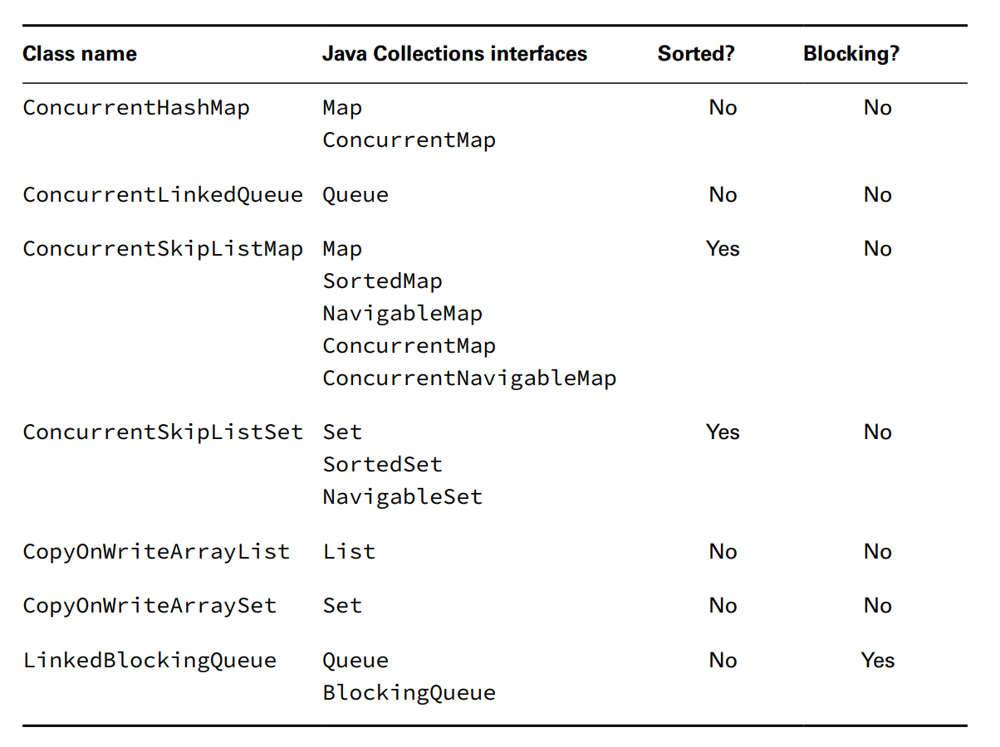
Chapter 13 – Concurrency

Slide 38
Chapter 13 – Concurrency
- Most of the classes in the table are all ... version of ... (for example ... map vs ... map, or ...list vs ...list)
- In the exam, we should know ... methods ... from the super ... and no need to understand detail ... in the class
– ..."skip" means ...
– ... "copyOnWrite" will behave different than the other ... These classes will ... whenever there is a new .../...ed/changed in the ... and update the ... to point from ... to ... These classes are used to ensure that the iterator doesnt ...
(code illustration snippet 34)
- Although we add ... but the ... didnt change, loop ran exactly ... time. If we replace ... with a ..., then we will get .... The ... class might consume a lot of ... because it ... => It is used for ... processing only when ... is much more ...
- CopyOnWrite instance kinda the same as ... object because it always ... when ...ed. But still doesnt look like pure ... because it still has the same ...
- In that table also have LinkedBlockingDeque which implements ... This guy is just normal ... but has some overloaded methods such as ... (), ...() that has timeout. These methods will wait ...

Slide 39
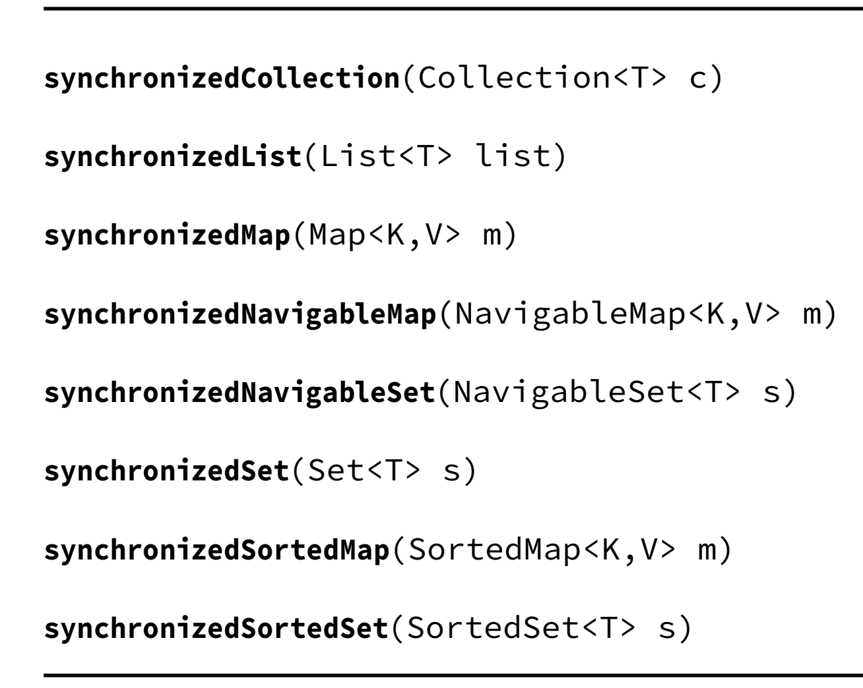
Chapter 13 – Concurrency
Obtaining Synchronized Collections
- Other than ... we just learned, Concurrency API also includes methods to obtain ... version from the non ... These methods work based on the passed ... and return a ... that has the same type as ...
(Note: The difference between synchronized ... and concurrent ... is ...)

Slide 40
Chapter 13 – Concurrency
Obtaining Synchronized Collections
- Other than ... we just learned, Concurrency API also includes methods to obtain ... version from the non ... These methods work based on the passed ... and return a ... that has the same type as ...
(Note: The difference between synchronized ... and concurrent ... is ...)
- If we are write code to create ... and it requires .., we should use the classes in the .... If we used the ... version, then we still can use the methods
Identifying Threading Problems
- Now we know how to write ... code, now we will see what satisfy as ... problem..
- A threading problem might happen in a ... application when 2 or more ... each other and create ... result (for example, 2 threads can ... each other from a ... segment). Concurrency API is created to mitigate ... in threading that can happen.
- As we can see Concurrency API creates ... for us and manages ... complex .... simple ...
- Although they are created to ..., it really doesnt ... it. The task of finding and ... is one of the most ...
Understading Liveness
- As we can see in this chapter, there are many independent ... that can be executed ... but they must still be ... each other
(for example, synchronization on a method will ... and force other .... We can also see the same thing with CyclicBarrier, where ...)

Slide 41
Chapter 13 – Concurrency
- The question is, what happens with the application when ... waiting...) In most cases, this ... is not long and user won't .... In some other cases, some of the wait is ... even ...
– Liveness is the ability of an ... with ... time ... optimized ...
- Liveness problem is when the app .../... at some state. More precisely, Liveness problem is a result of a thread ... forever or continuously... between ...
- In the exam, there are 3 liveness problem we should know ...,..., and ....
Deadlock
- DeadLock happens when 2 or more ... forever ... each other
(code illustration snippet 35)
Starvation
- Starvaton happens when a ... permenantly from a .../.... Although the ... is still active but it can't complete the ... because other ... are continuously ...the resource that it is trying to ...
Livelock
- Livelock happens when 2 or more ... permenantly, although ... Livelock is a special case of resource ... where both or more ... try to acquire the ... but it can't. Livelock is the consequence of a failed ...
(question 12)

Slide 42
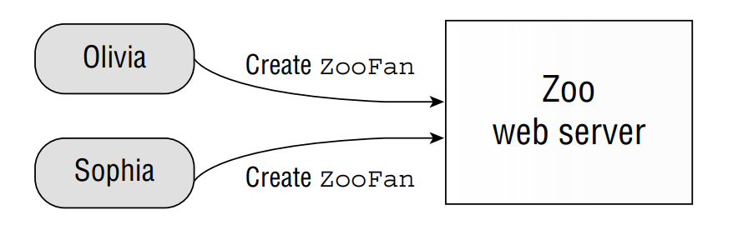
Chapter 13 – Concurrency
Managing Race Condition
- Race condition is an undesired result when 2 ... must be finished in order but ... We mentioned about this at the first ...
– The example below will demonstrate 2 persons want to create 2 accounts on the same server with the same username and send the request to the server simultaneously

Slide 43
Chapter 13 – Concurrency
- There are 3 possible...
+)
+)
+)
- The first case is the most dangerous because ...
- The second case is much better because ...
- The third case is the most optimal because ...
Working with Parallel Stream
- We end this chapter with Stream. One of the strength of Stream API is ...
- From the beginning of the ..., we study only ... which is called ... Stream.
- Serial Stream is a stream that its result is ... order ... element ...
- ... Stream allows us to process ... (for example, we could use ... stream, ...() operation to operate ... in parallel, increasing the ... in processing single .... in ... at the same time)
- Using Parallel Stream other than improving our ..., it also ... what we expect. Moreover, there are some ... must be handled in special way so that it can be used under ... condition

Slide 44
Chapter 13 – Concurrency
- The number of ... in ... stream is directly proportional to ... CPU
Creating Parallel Stream
- Stream API is designed ... easily
(code illustration snippet 36)
- Stream interface includes a method ...() that be used to check whether ... is a ... or not ... Some of the operation on ... can maintain the ... state while other ... won't
Performing a Parallel Decomposition
- Parallel decomposition is a process ... a task into ... that can be processed ... manner and can be reassembled into a final ...
– If the more ... the decompositon is, the more ... increased ...
- First we will define a reusable ... task (wait for ...)
(code illustration snippet 37)
- What happen if we change this to ...
(code illustration snippet 38)
- This code looks like we submitting ... and ...

Slide 45
Chapter 13 – Concurrency
Ordering Result
- If we need our stream to be 100% ...ed but we don't know whether it is ... or ... => we could use the ... method ...
(code illustration snippet 39)
- Although when we use this method, we will lost ..., but other ... stil make advantages of ...
Processing Parallel Reductions
- Other than improve ... and ... the operation, using parallel ... could affect how we write our own ...
– Parallel ... is a ... operation ... used for ... Stream. The result after a ... operation could be different than what we ... in ... Stream
Performing Order-based tasks
- Because ... Stream doesn't gurantee ..., it could cause unexpected ...
(code illustration snippet 40)
- JVM will allocate the number of ... and return the value corresponding to the first ... (which could be any value 4,2...)
- Although ...() is designed to find a number that has the best .... (could be the first ... in ... Stream, usually that, but not 100%), ...Stream might be even more ...
- Then what happen with the order-based operation such as ...(), ...(), or ...()
– Order is still maintained but with the cost of ... because all ... coordinated back to ... style

Slide 46
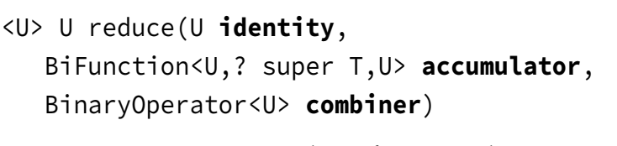
Chapter 13 – Concurrency
- On the bright side, the result of ... stream will be the same as ...stream
Creating Unordered Stream
- In all stream that we have ..., they are all ... stream by default
– We can create a ... stream from a ... stream (just like how we create ...stream from a ...stream)
(code illustration snippet 41)
- This method won't ... it will inform ... if this is a ...-based stream, then ignore it. (for example, if we have a ... stream and we call ...(5), then it will ... any 5 ... instead of ... 5 ...)
- For ..stream, this might sound ..., but for ..., this is ... because it will improve ...
(code illustration snippet 42)
Combining results with reduce()
- In chapter 10, we have told about ... operation reduce() (transform stream into ...)
- Remember that reduce() has 3 ..., ..., ..., and ...

Slide 47
Chapter 13 – Concurrency
- Note: the 3 ... version is for ...
(code illustration snippet 43)
- Note: the name of the ... is not accidental (c = ...; s1,s2,s3 = ...)
- In parallel stream, the method ...() works by using reduction on ... in a same ... to create ... value. Then, these ... value will be ... into final ...
– In ... Stream, the element ... order they ...
– In ... Stream, we must consider ...
- If the ... in the stream is combined in a way that it transforms into "wlof" or "flwo" (instead of "wolf") then what ?
– Stream API prevented these from happening while allowing ... as long as we stick to a rule: "both ... and ... must ... the same no matter ...."
- Although it is not in the exam, the ... and ... must be associative, stateless, and non-interfering. These are all related to ... => ...
- Although the requirement for ... and ... is correct for both ...stream and ...stream, we might not actually see the difference in ..stream because it is already ...But with ... stream, it wont be 100% ...
- If we violate ... then 100% it will produce ...
– We can see some of the examples below that uses problematic ... (as we know that the order matters when we do ... operation in math). The code below us will be different if we use ... stream instead of ...stream. We could remove the ... argument ... because the ... value type doesn't change

Slide 48
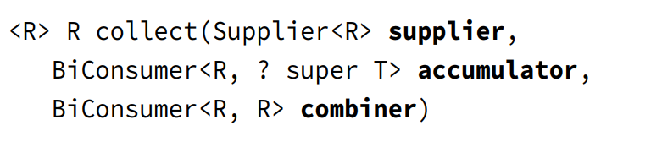
Chapter 13 – Concurrency
(code illustration snippet 44, 45)
- Although the 2 ... and 3... methods are all supporting ..., we are recommended to use the 3 ... because when working with .. processing, providing an explicit ... will allow JVM to ... the task and do it ...
Combining results with collect()
- Just like ...(), Stream API also provides a 3 ... for ...() that recieve ..., ... and ... instead of identity

Slide 49
Chapter 13 – Concurrency
- Just like ...(), ... and ... must be ... same and ... no matter ...
- Thanks to that ..., collect() can be ... processing
(code illustration snippet 46)
- We must remember that ... in a ConcurrentSkipListSet are sorted according to ... ordering. We should use a ... collection to gather ... to prevent ... from happening
- Executing ... with a collector requires careful consideration (for example, if the collection we use is a ordered ... like ..., the element in the final ... must also be ..., even if we are using ...stream or ...stream). This could reduce ... since some operation can't ...
Performing a Parallel Reduction on a Collector
- While we have studied on ... interface, we haven't dive deep into its .... Each collector ... has a method called ...() that return ... attribute. When using a Collector to perform ... reduction, we must have a set of ... set at ..., if not, then collect() will run as ... instead of ...
– Some of the requirement when doing ... using collect()
+)
+) concurrent
+) unordered

Slide 50
Chapter 13 – Concurrency
- For example, when Collectors.toSet() has ... but doesnt have ... => This code won't do a ... reduction even if it is a ...
- Collectors ... also have 2 ... to recieve Collectors which is to...() and group...(). These 2 guys have ... and ... characteristics
– These methods create ... instance that capable of ... reduction effectively. These are all ... version ...
(code illustration snippet 47,48)
Avoiding Stateful Streams
- Some of the side ... could happen in ...stream if the lambda expression is ...
- Stateful lambda expressions means its ... depends on external ... which could change during ... pipeline ....
(code illustration snippet 49)
- If we try this with ..stream, then it is ...
- But if we change to ...stream, then it will lose ... because ...
(code illustration snippet 50)
- It is stateful because ... a list that is outside ...
- The fix is when we done ..., convert ...
(code illustration snippet 51)

Slide 51
Chapter 13 – Concurrency
- This method will process ... and ... back to a List. It will produce a result ... same as ... what we ... We are recommended to avoid ... when working with ... to prevent side ... Moreover, we should avoid ... even in ...stream because it will make us harder to migrate our code from ... to ...stream ...

